Slide 1
Real Estate Market Analysis in Michigan and Midwest States (2021-2022)

Slide 2
Intro
Objective: Analyze real estate market trends in Michigan and the Midwest.
Focus: Property sales between 2021 and 2022.
Key Questions:
How did property sales compare in Michigan’s top 10 ZIP codes?
What are the sales trends across Midwest states?
Is there a correlation between population size and property sales?

Slide 3
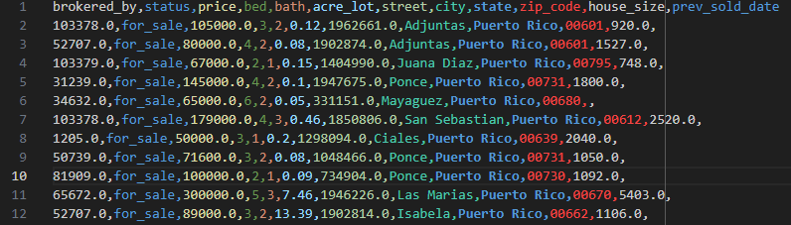
Dataset Overview
Source of Data:
Kaggle dataset scraped from realtor.com
"USA Real Estate Dataset" provides comprehensive information about real estate properties across the United States (and Puerto Rico and the Virgin Islands)
Sale data includes status, price, bedrooms, bathrooms, city, zip code, state, street, and house/lot size
Sold data includes information from November 2021 to April 2022

Slide 4
Cleaning the data
Dropped street data due to serialization
Performed .dropna() to filter out rows where data was mis
Focused only on 50 US states (dropped Puerto Rico and Virgin Islands)

Slide 5
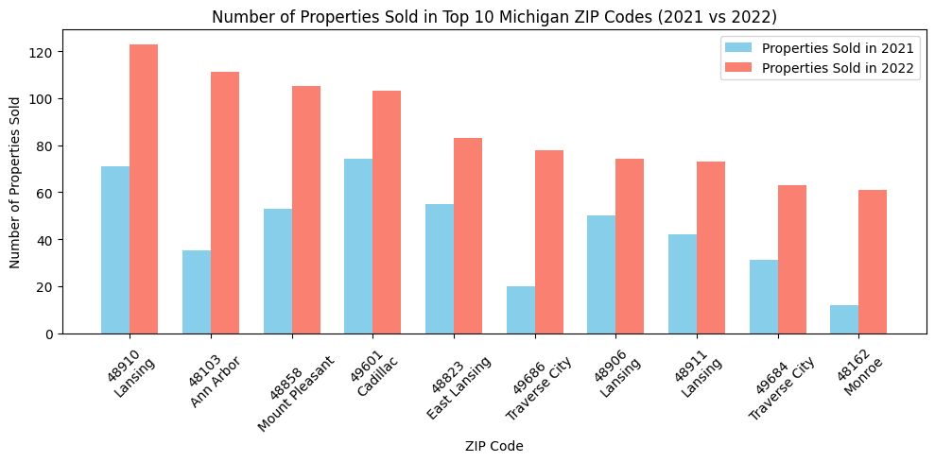
Initial Analysis of Top 10 Michigan ZIP Codes
Lansing appeared multiple times, leading to unreliable visualizations
Decision to pivot to city-based analysis for more accuracy
Didn’t like this output

Slide 6
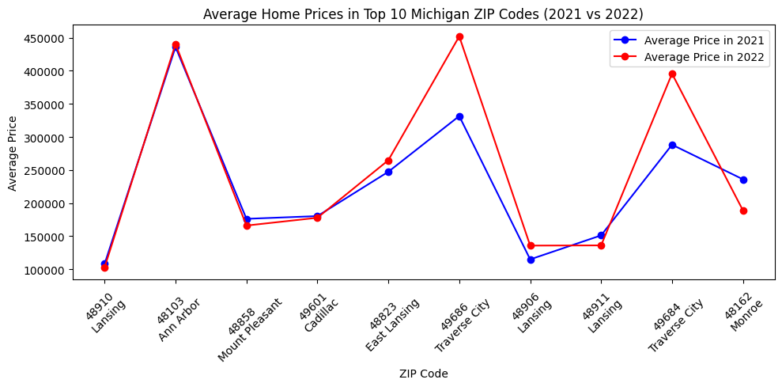
Initial Analysis of Top 10 Michigan ZIP Codes

Slide 7
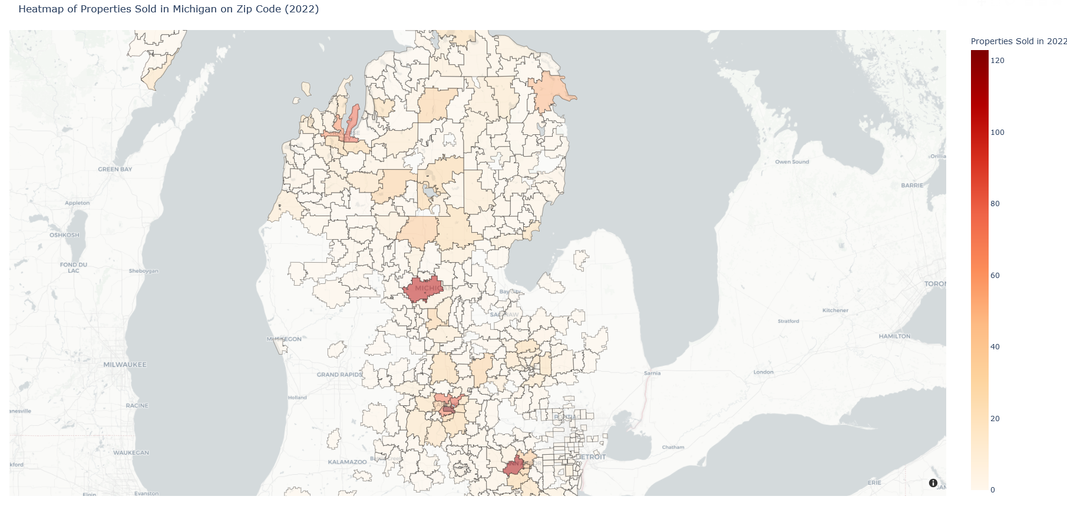
Zip code based heatmap
Mapped national shape file to state file for Michigan based on zip codes and location coordinates

Slide 8
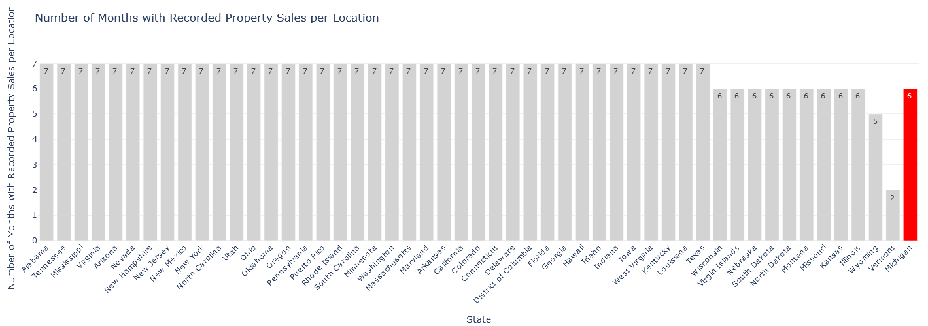
Focusing on sold data
Limited to 4Q 2021 and 1Q 2022

Slide 9
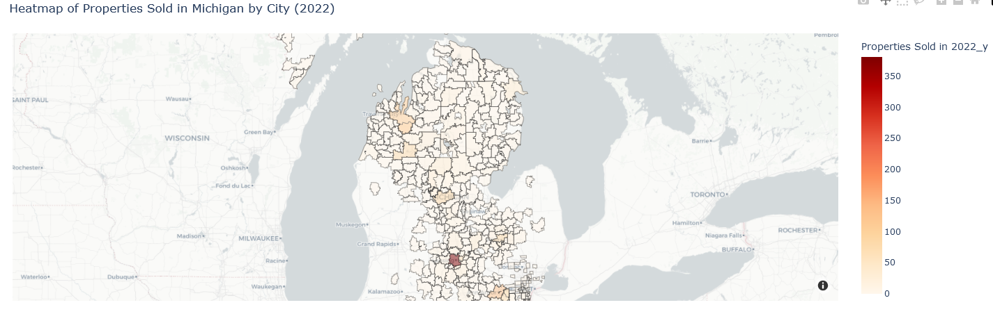
Pivot to city-based analysis
Shift to latitude and longitude data for city-level heatmaps
More accurate representation of property sales

Slide 10
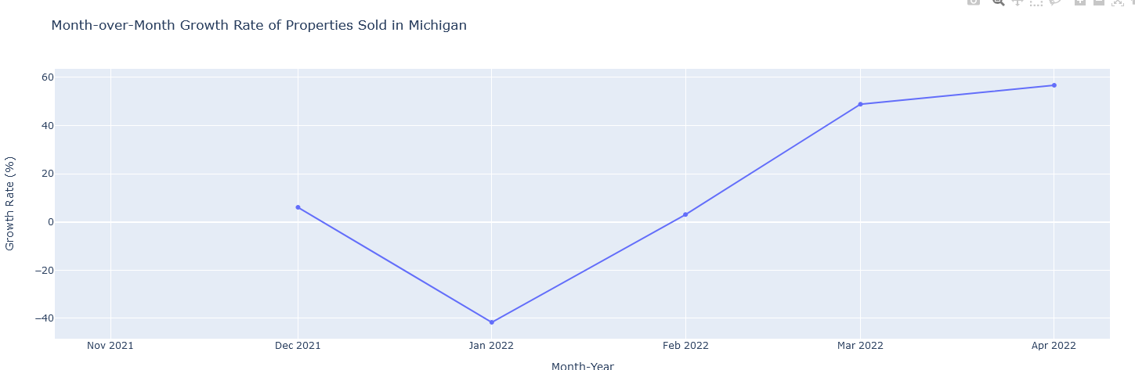
GROWTH RATE

Slide 11
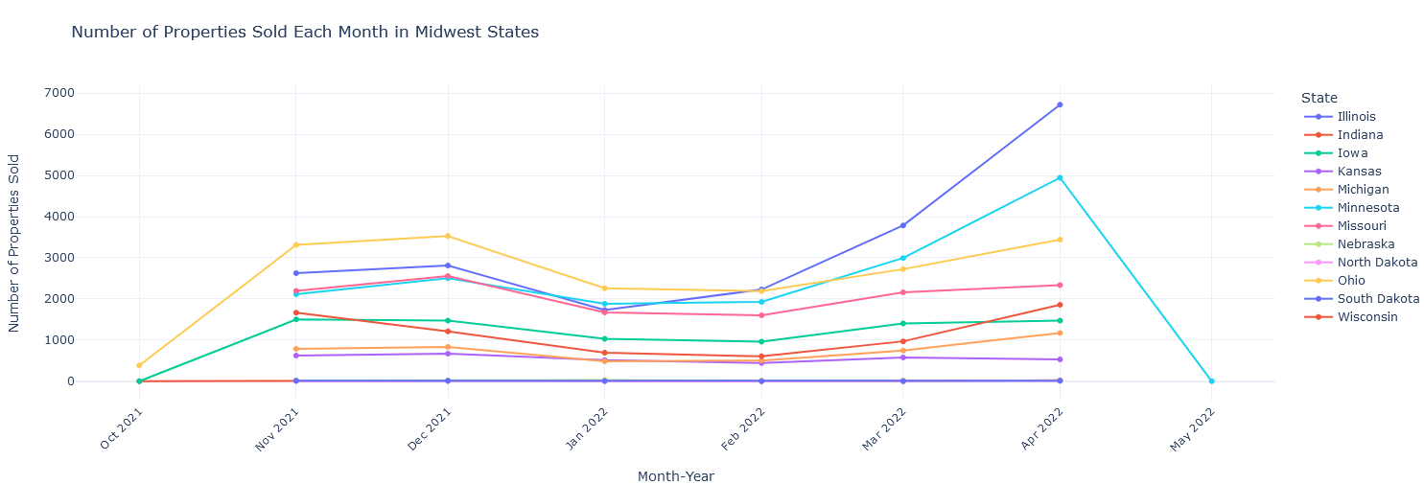
MIDWEST COMPARISON

Slide 12
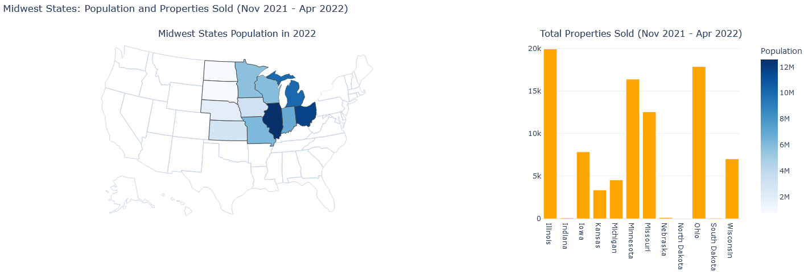
MIDWEST SALES BASED ON POPULATION

Slide 13
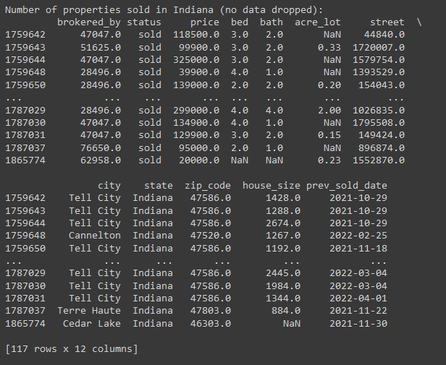
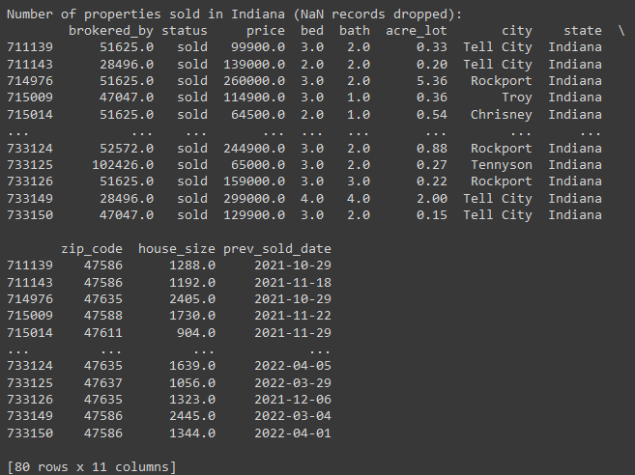
OUTLIERS?

Slide 14
Abandoned approaches
Attempted comparative analysis
Could not find datasets
Forecasting challenges
Only six months of data for Michigan
Impact of data cleaning
Reduced sampling size
Why was some data missing?

Slide 15

Thank you

